Slide 1

Unifying a Nation: A Data Science Solution
By Marcos Dominguez, Data Scientist

Slide 2
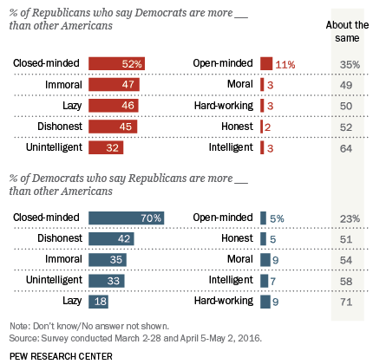
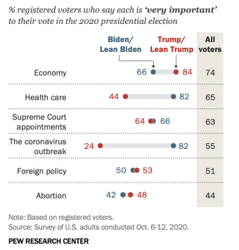
Nation remains divided
2016
2020

Slide 3
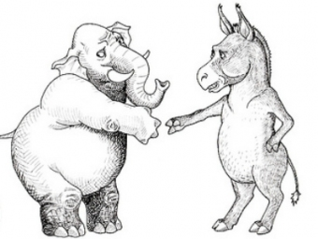
Tailor Biden’s speeches to appeal to opposition
Natural Language Processing
Extract Topics (Topic Modeling)
Tailor President-elect Biden’s speeches
Make allies, not enemies

Slide 4

NLP in a nutshell
Trump speech text
Clean, decipher and analyze text
Topic 1
Topic 2
Topic 3

Slide 5

Implementation of NLP
8 Speeches in October 2020
Arizona
Nebraska
Wisconsin
Michigan
Analyzed for topic modeling

Slide 6
NLP Steps
Step 1: Web-scrape text
Step 2: Remove punctuation, unnecessary words
Step 3: Extract topics
Step 4: Assign probability of topic to each sentence
Step 3: Divide into sentences

Slide 7
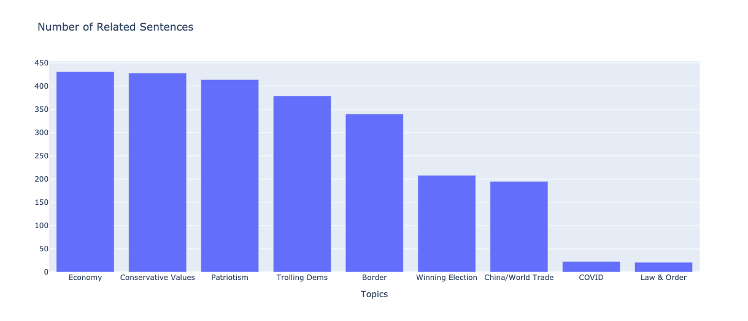
Overall Topics

Slide 8
President-elect recommended talking points
State | Topics | Talking Points
Arizona | Conservative Values, Law & Order | “open-carry” gun laws AND common-sense gun reform
Michigan | Economy, COVID, Conservative Values | “open-carry” gun laws AND common-sense gun reform
Nebraska | Law & Order, Economy, COVID | COVID safety AND rebuilding economy
Wisconsin | COVID, Border | COVID safety AND rebuilding economy

Slide 9
Future work: research speeches of previous crisis-era presidents
Great Recession
Great Depression/WWII
Civil War

Slide 10

Acknowledgments
Contact: md.ghsd@gmail.com
Open-source:
Python
Pandas, Numpy
Scikit-learn
spaCy
Plotly
Pew Research, 2016 Poll
Pew Research, 2020 Poll
Trump Speech Transcripts
Github repo:
github.com/mdominguez2010/Trump-Speech-NLP

